Slide 1
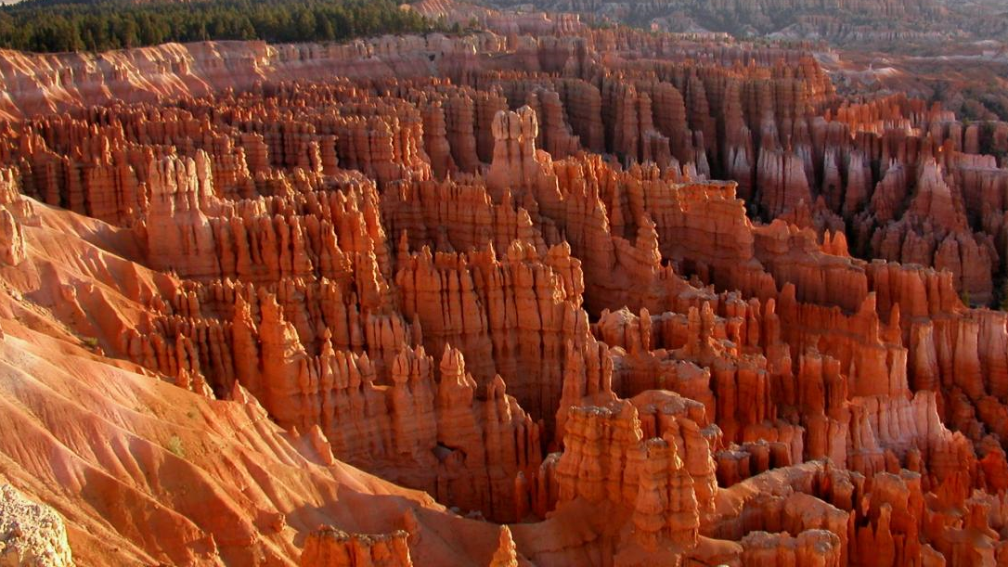
Ancient Sedimentary Environments
GEOL 1602 Lab 3

Slide 2
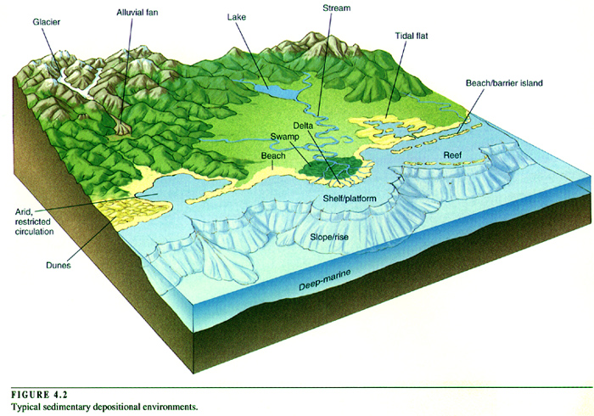
Depositional Environments
Environments of deposition vary in
Climate: arid vs humid.
Energy: mountainous regions are higher energy environments; beaches are moderate; and meandering rivers, lakes are generally low.
Sediment sizes that can be mobilized and deposited.

Slide 3
Depositional Environments
Terrestrial (non-marine)
Alluvial fans
River floodplains
Lakes
Glaciers
Eolian (windswept)
Swamps
Marine
Shallow marine
Deep marine
Transitional
Deltas
Beaches
Lagoons
Tidal Flats

Slide 4
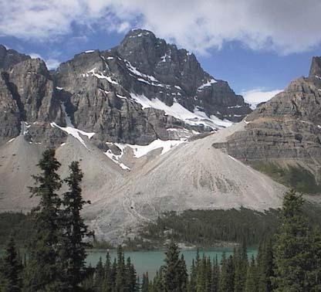
Alluvial Fans
Alluvial fans typically form where flow emerges from a confined channel and is free to spread out.
This reduces the carrying capacity of the flow and results in deposition of sediments.

Slide 5
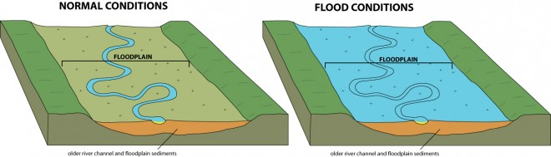
River Floodplains
Lowlands composed of river deposits.
Overflows during flood stages.

Slide 6
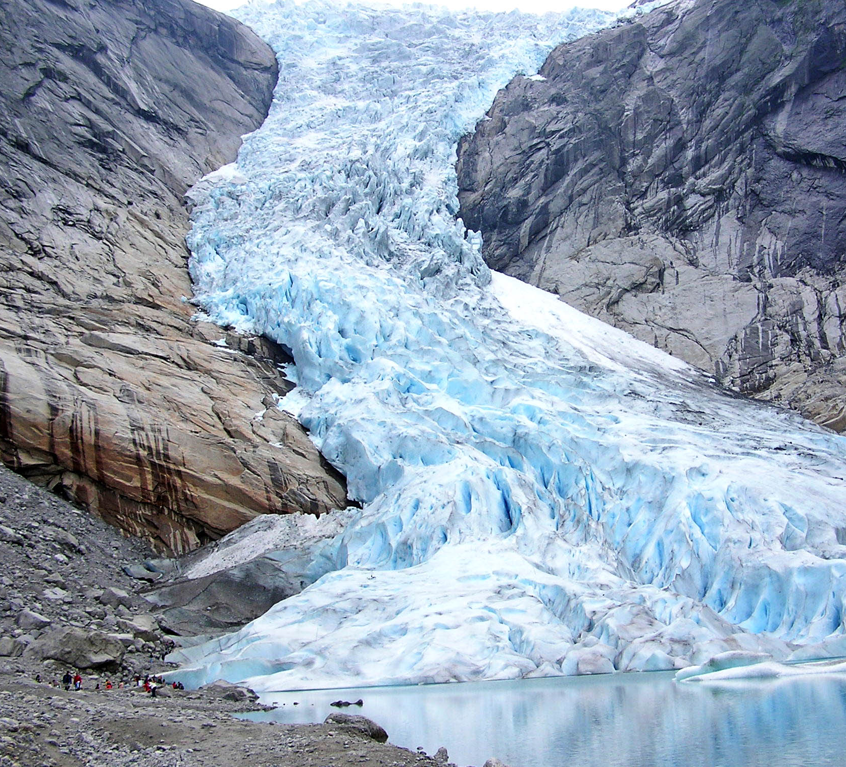
Glaciers
Volumes of rock debris including boulders.
Poorly sorted.

Slide 7
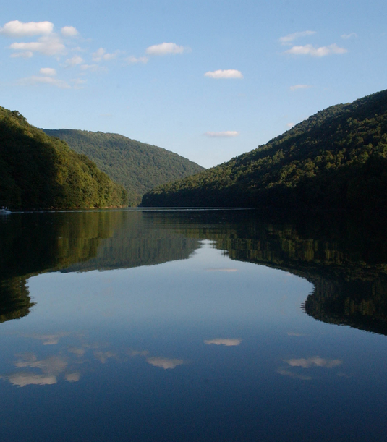
Lacustrine
Lacustrine deposits are sedimentary rock formations which formed in the bottom of ancient lakes.
Desert lacustrine: ephemeral playa lakes.

Slide 8
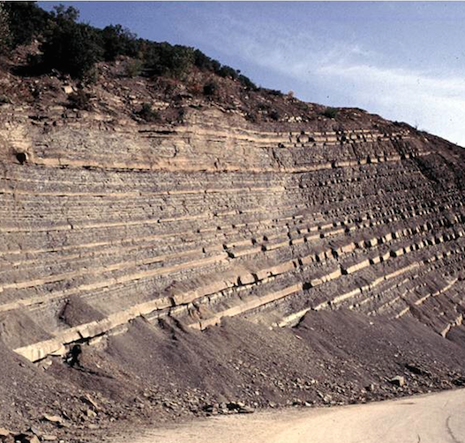
Deep Marine
Distal marine fan deposits composed of sandy and muddy turbidite beds
Deep ocean basins provide the largest areas of sediment accumulation on Earth, but they are also some of the least accessible.
Evidence for deposition in deep water may sometimes be based on the absence of shallow water structures as well as (or more than) identifying positive deep water indicators

Slide 9
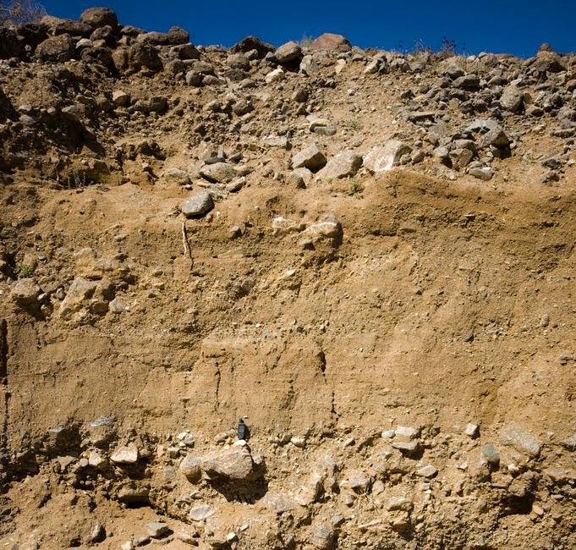
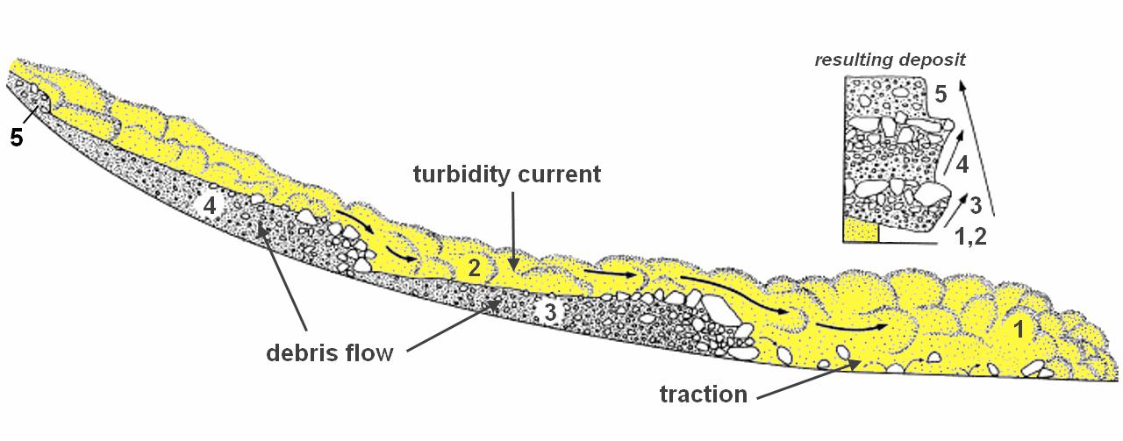
Graded Bedding
Coarser sediment at the bottom.
Finer sediment towards the top.
Usually a product of turbidity currents.

Slide 10
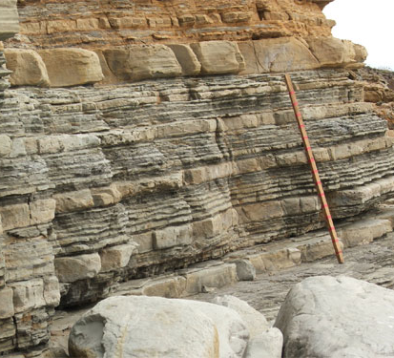
Planar Bedding
Can form in any sedimentary environment.
Laterally extensive.
Can be disrupted by bioturbation.
Burrowing organisms

Slide 11
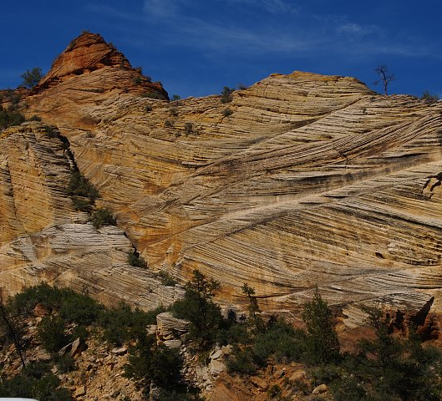
Cross Bedding
A feature that occurs at various scales, and is observed in conglomerates and sandstones.
It reflects the transport of gravel and sand by currents that flow over the sediment surface (e.g. in a river channel).
Cross-bedding can also be produced when wind blows over a sand surface and creates sand dunes.

Slide 12
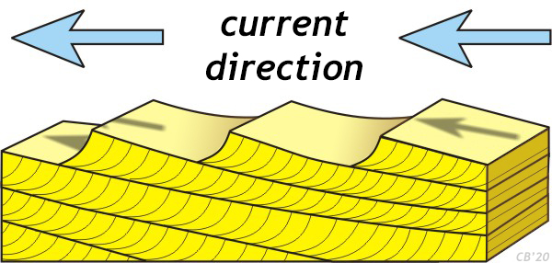
Cross Bedding
A feature that occurs at various scales, and is observed in conglomerates and sandstones.
It reflects the transport of gravel and sand by currents that flow over the sediment surface (e.g. in a river channel).
Cross-bedding can also be produced when wind blows over a sand surface and creates sand dunes.

Slide 13
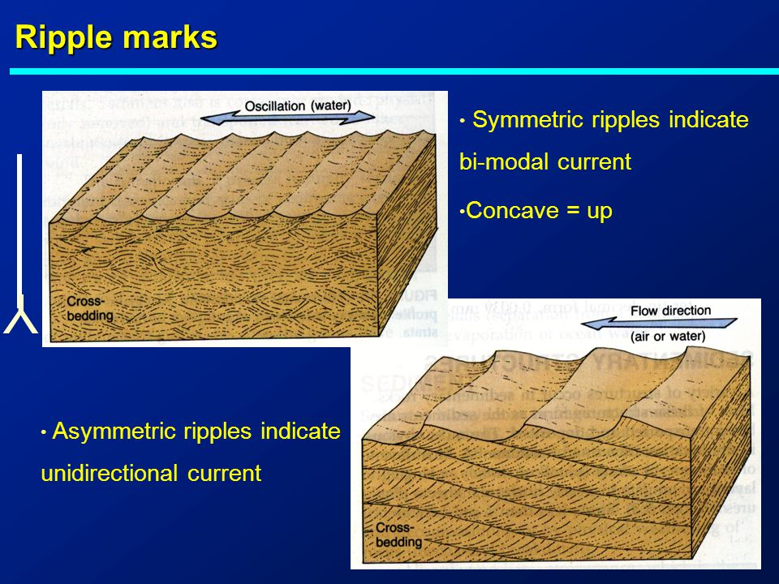
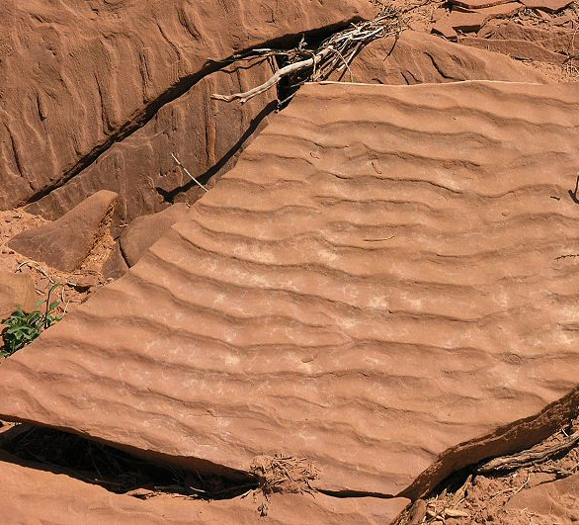
Ripple Marks
Can be symmetric or asymmetric.
Produced by flowing water or wave action, analogous to cross-bedding (see above), only on a smaller scale, individual layers are at most a few cm thick.

Slide 14
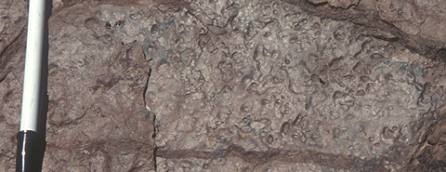
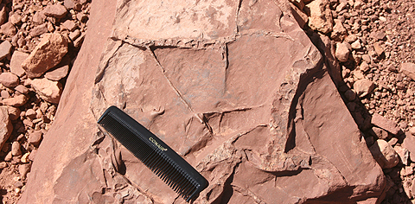
Bedding plane structure
A class of sedimentary structures form on the interface between beds, usually on the exposed surface of a recently deposited bed before it is buried. These features are useful because they indicate current direction and post-depositional deformation of the sediment.
Rain drop casts in Gettysburg FM, Rocky Ridge, MD
Mud cracks
Rain drop prints
Sole marks
Mud crack in Moenkopi Fm. Barringer Crater, AZ

Slide 15
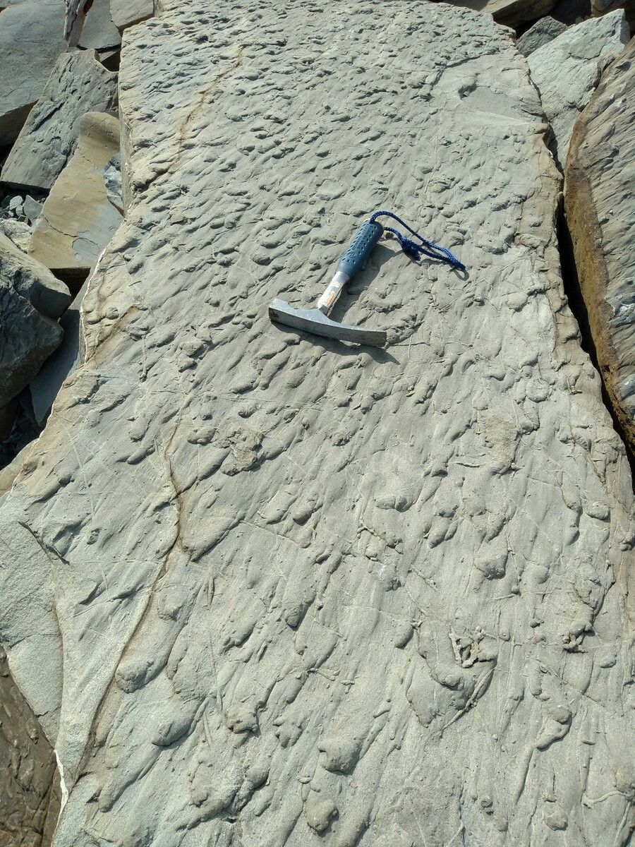
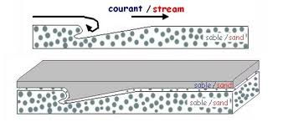
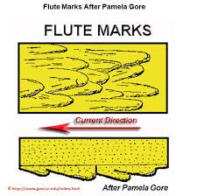
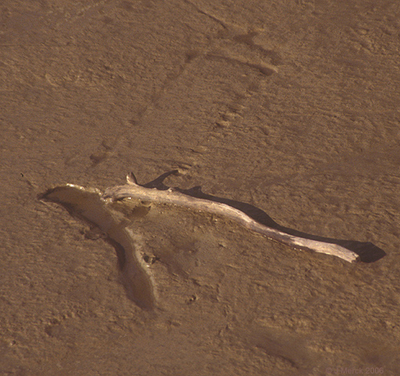
Sole Marks
Sole marks are formed by currents acting on sediment.
Flute casts: Elongate teardrop shaped depressions that taper upstream. Caused by the scouring action of turbulent flow, common in turbidity currents.
Tool mark: Indention of the cohesive mud bottom by a "tool," and object dragged across sediment by current (right).
Tool mark caused by floating branch, Roosevelt Island, DC

